Slide 1
Police data analysis
Project For Bell, by Zaid

Slide 2
Gathering The Data
Data was downloaded as 3 different csv files from Toronto Police.
Each csv file is for a different type of crime.
Most documented crimes are Assault, Theft from Vehicle and Breaking-and-Entering.

Slide 3
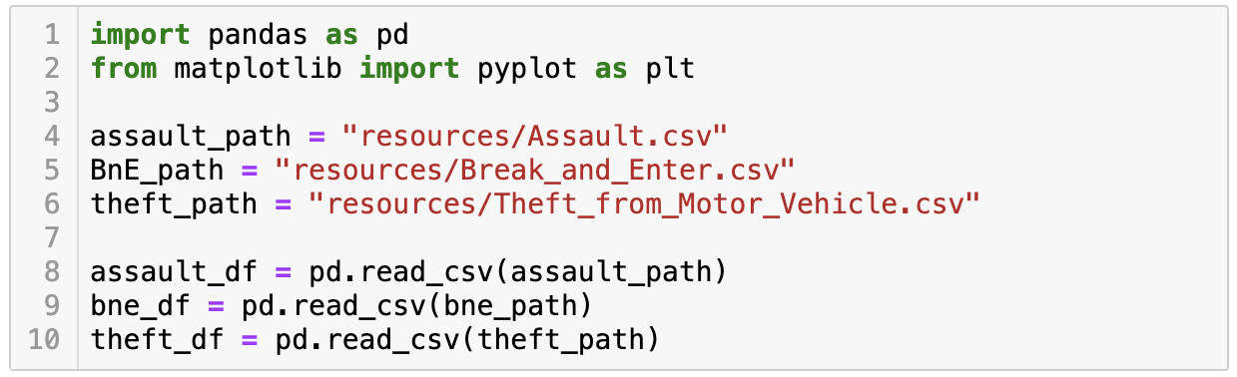
Importing Libraries and csv Files

Slide 4
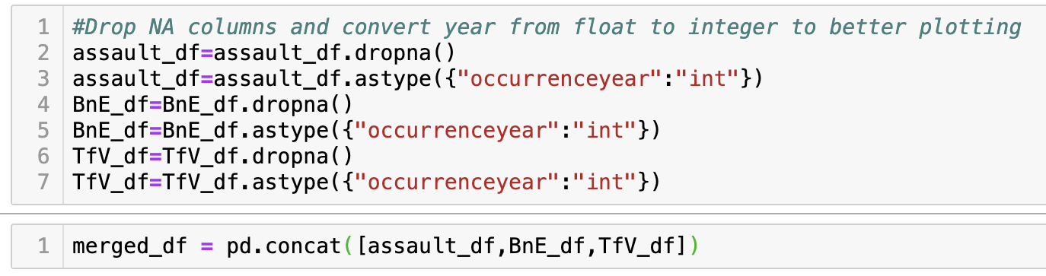
Cleaning, Converting and Merging

Slide 5
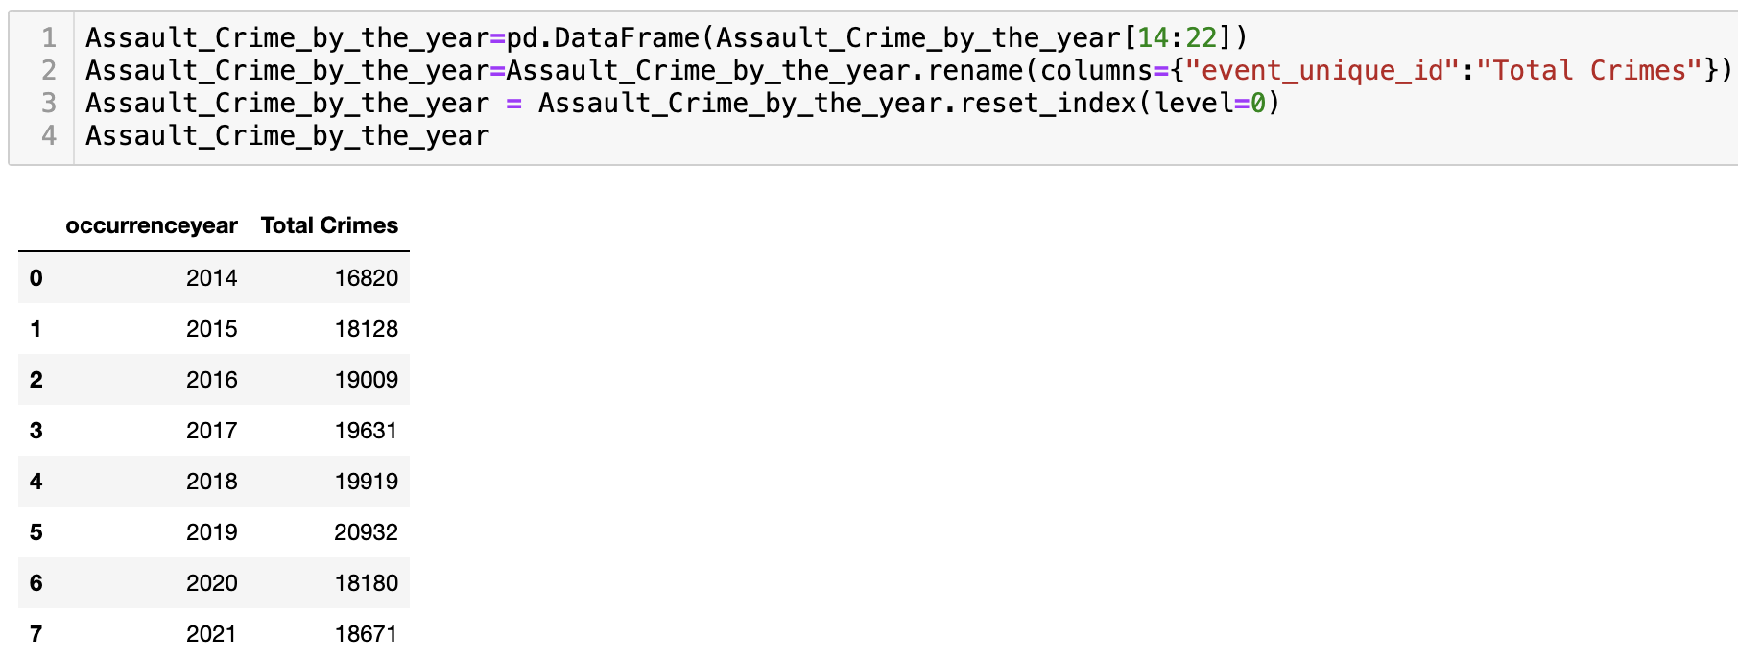
Narrowing the Data

Slide 6
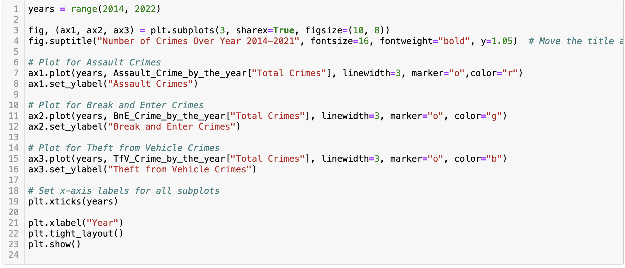
Plotting the Data

Slide 7
